Slide 1
Lecture 13 Sorting Algorithm
Department of Computer Science
Hofstra University

Slide 2
Lecture Goals
We introduce binary heap for priority queue data abstract, which leads to an efficient sorting algorithm known as heapsort.
We introduce and implement the randomized quicksort algorithm and analyze its performance.
We study the mergesort algorithm and show that it guarantees to sort any array of n items with at most nlog(n) compares.

Slide 3
Heapsort: Binary Heap
In a heap the highest (or lowest) priority element is always stored at the root, hence the name "heap". A heap is useful data structure when you need to remove the object with the highest (or lowest) priority. A common use of a heap is to implement a priority queue and heapsort.
A binary heap is a complete binary tree which is an efficient data structure satisfies the heap ordering property.
In a complete tree, every level (except possibly the last) is completely filled; the last level is filled from left to right.
complete binary tree with n = 16 nodes (height = 4)

Slide 4
Heapsort: Binary Heap
The heap ordering can be one of two types:
The min-heap property: the value of each node is greater than or equal to the value of its parent, with the minimum-value element at the root.
The max-heap property: the value of each node is less than or equal to the value of its parent, with the maximum-value element at the root.
A heap is not a sorted structure and can be regarded as partially ordered. As you see from the picture, there is no particular relationship among nodes on any given level, even among the siblings.
Since a heap is a complete binary tree, it has a smallest possible height - a heap with n nodes has O(log n) height.
in this lecture
1
9
4
2
8
5
7
9
8
6
2
1
Min Heap Animations | Data Structure | Visual How
https://www.youtube.com/watch?v=AFPzC2RJOMk
Max Heap Animations | Data Structure | Visual How
https://www.youtube.com/watch?v=uU0iWaVxMgc

Slide 5
Binary Heap vs. Binary Search Tree
Binary Heap is different from Binary Search Tree (e.g., red-black tree)
Binary Heap: the max-heap property
Value of each node is less than or equal to the value of its parent, with the maximum-value element at the root.
Binary Search Tree: Ordered, or sorted, binary trees
Items to the left of a given node are smaller.
Items to the right of a given node are larger.
Both structures offer O(log n) time complexity for certain operations, they are used in different scenarios.
Heapsort is used for efficient sorting and simple priority queue implementations
Red-black trees are for maintaining ordered data with frequent updates and searches
Red-black trees can also be used for sorting, by insertions followed by in-order traversal, with O(n log(n)) complexity, but is less efficient in terms of memory and execution time than efficient sorting algorithms.
9
8
5
6
2
1
Binary Heap
8
5
10
1
7
9
Binary Search Tree
Notes:
Each node can have 2 subtrees.

Slide 6


Binary Heap: Array Representation
Array representation.
Indices range in [1, n].
Take nodes in level order.
No explicit links needed!
i 0 1 2 3 4 5 6 7 a[i] - T S R P N O A
8 9 10 11
E I H G
T
S R
P N O A
1
T
2
S
3
R
E I H G
4 P
5
N
6
O
7
A
8
E
9
I
10
11
H G
Heap representations
Proposition. Largest key is a[1], which is root of binary tree.
Leaf nodes have indices [floor(n/2)+1, n]
[floor(11/2)+1, n]=[6, 11]
Non-leaf nodes have indices [1, floor(n/2)]
[1, floor(11/2)]=[1, 5]
Proposition. Can use array indices to move through tree.
Parent of node at k is at floor(k/2).
Parent of node at 8 or 9 is at floor(8/2)= floor(9/2)=4.
Children of node at k are at 2k and 2k+1.
Children of node at 4 is at 2*4=8 and 2*4+1=9

Slide 7
Binary Heap Operations: Promotion
Scenario. A key becomes larger than its parent’s key.
To eliminate the violation:
Exchange key in child with key in parent.
Repeat until heap order restored.
S
P
R
N
5
T
O
A
violates heap order (larger key than parent)
private void swim(int k)
{
while (k > 1 && less(k/2, k))
{
exch(k, k/2); k = k/2;
E
I
H
G
1
T
2
S
R
}
parent of node at k is at k/2
N
5
P
O
A
}
E
I
H
G

Slide 8

Binary Heap Operations: Insert
Insert. Add node as leaf, then swim it up.
Cost. O(log n) compares since tree height is O(log n).
insert
T
T
P
R
P
R
N
H
O A
key to insert
N
H
O
A
add key to heap violates heap order
E
I
G
S
E
I
G
S
T
S R
P O
G H
public void insert(Key x)
{
pq[++n] = x; swim(n);
}
swim up
N
A
E
I

Slide 9

Binary Heap Operations: Demotion
Scenario. A key becomes smaller than one (or both) of its children’s.
To eliminate the violation:
Exchange key in parent with key in larger child.
Repeat until heap order restored.
(Called max_heapify in video)
violates heap order (smaller than a child)
T
private void sink(int k, int n)
{
2 _{H}
R
P
5
S
O
A
while (2*k <= n)
{
int j = 2*k;
children of node at k
are 2*k and 2*k+1
E
I
N
G
if (j < n && less(j, j+1)) j++; if (!less(k, j)) break;
exch(k, j); k = j;
T
2
S
R
P
5
N
O
A
E
I
10
H
G
}
}
Top-down max_heapify (sink)

Slide 10

Binary Heap Operations: DeleteMax
Delete max. Exchange root with node at end, then sink it down.
Cost. O(log n) compares.
remove the maximum
T
key to remove
H
violates heap order
R
O A
S
R
S
N
P
O A
exchange key with root
N
P
E
I
G
H
E
I
G
T
remove node from heap
public Key delMax()
{
Key max = pq[1]; exch(1, n--); sink(1);
pq[n+1] = null;
S
sink down
P
R
N
H
O
A
E
I
G
return max;
}

Slide 11
Binary Heap: Practical improvements
Multiway heaps. Complete d-way tree.
Parent’s key no smaller than its children’s keys.
Fact. Height of complete d-way tree on n nodes is ~ log _{d} n.
Z
Y
T
G
J
X
P
W
I
K
A
B
D
E
H
F
R
S
V
C
L M
Q N O
3-way heap

Slide 12
Heapsort Algorithm
Basic plan for in-place sort.
View input array as a complete binary tree.
Heap construction: build a max-heap with all n keys.
Sortdown: repeatedly remove the maximum key.
keys in arbitrary order
build max heap (in place)
sorted result (in place)
1
S
X
1 _{A}
2
3
2 _{E}
3 _{E}
6 _{O} 7 _{P}
O
R
7
T
S
4
5
6
4 _{L}
M
11
T E
8 9 10 _{L} 11 _{E}
X A
P
L
R A
5
M P
M
O E E
8
9
10
R
S T X
1 2 3 4 5 6 7 8 9 10 11
1 2 3 4 5 6 7 8 9 10 11
1 2 3 4 5 6 7 8 9 10 11
S | O | R | T | E | X | A | M | P | L | E
X | T | S | P | L | R | A | M | O | E | E
A | E | E | L | M | O | P | R | S | T | X
Notes:
Heaps and Heap Sort NG
https://www.youtube.com/watch?v=H5kAcmGOn4Q

Slide 13
Heapsort: Heap Construction
for (int k = floor(n/2); k >= 1; k--) //call sink(k) on all non-leaf nodes k from bottom up
sink(k, n);
First pass. Build heap using bottom-up method.
1
S
sink(3)
S
2
O
3
R
7
O
X
4
T
9 10
5
E
11
6
X
A
L
T
R A
8
M P L E
M
P E E
3-node heap
starting point (arbitrary order)
1-node heap
sink(5, 11)
S
7-node heap
sink(2, 11)
S
O
R
T
X
T
L
X A
P
L
R A
M P E E
M O E
E
3-node heap
11-node heap
sink(4, 11)
S
sink(1, 11)
X
O
R
T
S
T
L
X A
P
L
R A
3-node heap
M
P E E
M O E E
result (heap-ordered)

Slide 14































Heapsort: Sortdown
Second pass.
Remove the maximum, one at a time.
Leave in array, instead of nulling out.
while (n > 1)
{
exch(a, 1, n--);
sink(a, 1, n);
}
X
exch(1, 9)
sink(1, 8)
R
exch(1, 6)
sink(1, 5)
T
S
P
E
M
exch(1, 3)
sink(1, 2)
E
P
L
R
A
O
L
E A
L
E
A
E
M O E E
starting point (heap-ordered)
M S T
X
A
E
O P
L
M
O P
R S T X
R S T
X
exch(1, 11)
sink(1, 10)
T
exch(1, 8)
sink(1, 7)
P
exch(1, 5)
sink(1, 4)
L
exch(1, 2)
sink(1, 1)
A
P
S
O
E
E
E
E
E
O
L
R
A
M
L
E A
A
M
O
P
L
M
O P
M E E X
R S T X
R S T X
R S T X
exch(1, 10)
sink(1, 9)
S
exch(1, 7)
sink(1, 6)
exch(1, 4)
sink(1, 3)
E
1 _{A}
P
R
O
A
E
2 _{E}
3 _{E}
L
E A
M
E
M
4 _{L} 5 _{M}
6 _{O} 7 _{P}
O
A
L
E P
L
O P
8 _{R} 9 _{S} 10 _{T} 11 _{X}
result (sorted)
M E T X
R
S T X
R S T X

Slide 15
Heapsort: Java Implementation
public class Heap
{
public static void sort(Comparable[] a)
{
int n = a.length;
for (int k = n/2; k >= 1; k--)
sink(a, while (n > { | k, 1) | n);
exch(a, | 1, | n);
sink(a, | 1, | --n);
O(nlogn)
}
}
private static void sink(Comparable[] a, int k, int n)
{ /* as before */ }
but make static (and pass arguments)
private static boolean less(Comparable[] a, int i, int j)
{ /* as before */ }
private static void exch(Object[] a, int i, int j)
{ /* as before */ }
but convert from 1-based indexing to 0-base indexing
}

Slide 16
Heapsort: Trace
sink(K, N)
a[i]
N | k | 0 | 1 | 2 | 3 | 4 | 5 | 6 | 7 | 8 | 9 | 10 | 11
initial | values |  | S | O | R | T | E | X | A | M | P | L | E
11 | 5 |  | S | O | R | T | L | X | A | M | P | E | E
11 | 4 |  | S | O | R | T | L | X | A | M | P | E | E
11 | 3 |  | S | O | X | T | L | R | A | M | P | E | E
11 | 2 |  | S | T | X | P | L | R | A | M | O | E | E
11 | 1 |  | X | T | S | P | L | R | A | M | O | E | E
heap-ordered X T S P L R A M O E E
10 | 1 | T |  | P | S | O | L | R | A | M | E | E | X
9 | 1 | S |  | P | R | O | L | E | A | M | E | T | X
8 | 1 | R |  | P | E | O | L | E | A | M | S | T | X
7 | 1 | P |  | O | E | M | L | E | A | R | S | T | X
6 | 1 | O |  | M | E | A | L | E | P | R | S | T | X
5 | 1 | M |  | L | E | A | E | O | P | R | S | T | X
4 | 1 | L |  | E | E | A | M | O | P | R | S | T | X
3 | 1 | E |  | A | E | L | M | O | P | R | S | T | X
2 | 1 | E |  | A | E | L | M | O | P | R | S | T | X
1 | 1 | A |  | E | E | L | M | O | P | R | S | T | X
sorted | result | A |  | E | E | L | M | O | P | R | S | T | X
3-node heap
7-node heap
11-node heap
red: exchanged
black: compared
Heapsort trace (array contents just after each sink)

Slide 17
Quicksort
Quicksort is a widely used sorting algorithm based on the divide-and-conquer approach.
## Pivot Selection in Quicksort
The pivot is an element chosen from the array that serves as a reference point for partitioning the array into two subarrays. There are several strategies for selecting the pivot:
###First or Last Element as Pivot. One common approach is to choose the last element of the array as the pivot. This method is simple to implement but can lead to poor performance if the array is already sorted or nearly sorted.
We use the first element as Pivot in the examples.
### Random Element as Pivot. Selecting a random element as the pivot can help avoid worst-case scenarios and provide more consistent performance across different input distributions.
### Median-of-Three. This method selects the median of the first, middle, and last elements of the array as the pivot. It often provides a good balance between simplicity and performance.
## Partitioning Process
Once the pivot is selected, the partitioning process begins:
1. The pivot is compared with each element in the array.
2. Elements smaller than the pivot are moved to its left.
3. Elements larger than the pivot are moved to its right.
4. The pivot is placed in its final sorted position.
Notes:
## Recursive Implementation
After partitioning, the quicksort algorithm recursively applies the same process to the subarrays on either side of the pivot until the entire array is sorted[1][3].
## Code Example (Python)
Here's a basic implementation of quicksort using the last element as the pivot:
```python
def partition(array, low, high):
pivot = array[high]
i = low - 1
for j in range(low, high):
if array[j] <= pivot:
i += 1
array[i], array[j] = array[j], array[i]
array[i + 1], array[high] = array[high], array[i + 1]
return i + 1
def quickSort(array, low, high):
if low < high:
pi = partition(array, low, high)
quickSort(array, low, pi - 1)
quickSort(array, pi + 1, high)
# Example usage
data = [8, 7, 2, 1, 0, 9, 6]
size = len(data)
quickSort(data, 0, size - 1)
print('Sorted Array:', data)
```
## Performance Considerations
The choice of pivot can significantly affect the algorithm's performance:
- **Best-case scenario**: The pivot consistently divides the array into roughly equal halves, resulting in O(n log n) time complexity.
- **Worst-case scenario**: Poor pivot selection (e.g., always choosing the smallest or largest element) can lead to O(n^2) time complexity.
## Advanced Pivot Strategies
Research has explored more sophisticated pivot selection methods to improve quicksort's performance:
- **Multi-pivot quicksort**: This variant uses multiple pivots to partition the array, potentially reducing the number of comparisons and improving cache efficiency[2].
- **Median of medians**: This algorithm guarantees a good pivot selection, ensuring O(n log n) worst-case time complexity, but is rarely used in practice due to its overhead[4].
By carefully choosing the pivot and implementing optimizations, quicksort remains one of the most efficient and widely used sorting algorithms in practice.
Citations:
[1] https://www.geeksforgeeks.org/quick-sort-algorithm/
[2] https://cs.stanford.edu/~rishig/courses/ref/l11a.pdf
[3] https://www.programiz.com/dsa/quick-sort
[4] https://en.wikipedia.org/wiki/Quicksort
[5] https://builtin.com/articles/quicksort
[6] https://stackoverflow.com/questions/164163/quicksort-choosing-the-pivot
[7] https://www.youtube.com/watch?v=Vtckgz38QHs
[8] https://algs4.cs.princeton.edu/23quicksort/

Slide 18
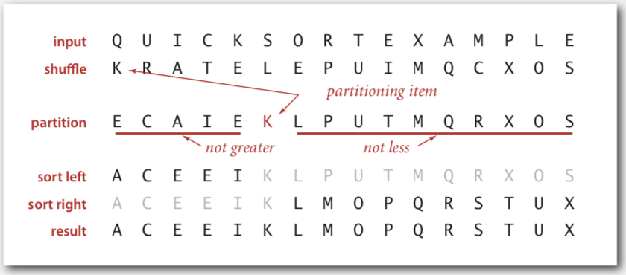
Quicksort
Shuffle the array.
Partition so that, for some pivot j
entry a[j] is in place
no larger entry to the left of j
no smaller entry to the right of j
Sort each piece recursively.
Quick Sort Animations | Data Structure | Visual How
https://www.youtube.com/watch?v=4vc5OYLMcYE

Slide 19
Partition Operation
Repeat until i and j pointers cross.
Scan i from left to right so long as (a[i] < a[lo]).
Scan j from right to left so long as (a[j] > a[lo]).
Exchange a[i] with a[j].
When pointers cross.
Exchange a[lo] with a[j].
K
R
A
T
E
L
E
P
U
I
M
Q
C
X
O
S
K
R
A
T
E
L
E
P
U
I
M
Q
C
X
O
S
pivot
lo
i
j
j
j
j
K
C
A
T
E
L
E
P
U
I
M
Q
R
X
O
S
lo
i
i
i
j
j
j
j
K
C
A
I
E
L
E
P
U
T
M
Q
R
X
O
S
lo
i
i
i
j
j
j
j
K
C
A
I
E
E
L
P
U
T
M
Q
R
X
O
S
lo
j
i
j
i
E
C
A
I
E
K
L
P
U
T
M
Q
R
X
O
S
lo
j
i
hi

Slide 20







Partition Operation: Java Implementation
private static int partition(Comparable[] a, int lo, int hi)
{
int i = lo, j = hi+1; while (true)
{
while (less(a[++i], a[lo]))
if (i == hi) break;
find item on left to swap
while (less(a[lo], a[--j]))
if (j == lo) break;
find item on right to swap
if (i >= j) break; exch(a, i, j);
check if pointers cross
swap
}
exch(a, lo, j); return j;
swap with partitioning item return index of item now known to be in place
}
before v
lo
during
v | $≤$ v |  | $≥$ v
after
$≤$ v
v
$≥$ v
hi
i
j
lo
j
hi

Slide 21

Quicksort: Java Implementation
public class Quick
{
private static int | partition(Comparable[] | a, | int | lo, | int | hi)
{/* see previous | slide / }
public static void sort(Comparable[] a)
{
StdRandom.shuffle(a); sort(a, 0, a.length - 1);
Shuffle needed for performance guarantee
}
private static void sort(Comparable[] a, int lo, int hi)
{
if (hi <= lo) return;
int j = partition(a, lo, hi);
sort(a, lo, j-1);
sort(a, j+1, hi);
}
}
Pivot selection

Slide 22

Quicksort: Trace
initial values random shuffle
lo j hi 0 1 2 3 4 5 6 7 8 9 10 11 12 13 14 15
 |  |  | Q | U | I | C | K | S | O | R | T | E | X | A | M | P | L | E
 |  |  | K | R | A | T | E | L | E | P | U | I | M | Q | C | X | O | S
0 | 5 | 15 | E | C | A | I | E | K | L | P | U | T | M | Q | R | X | O | S
0 | 3 | 4 | E | C | A | E | I | K | L | P | U | T | M | Q | R | X | O | S
0 | 2 | 2 | A | C | E | E | I | K | L | P | U | T | M | Q | R | X | O | S
0 | 0 | 1 | A | C | E | E | I | K | L | P | U | T | M | Q | R | X | O | S
1 |  | 1 | A | C | E | E | I | K | L | P | U | T | M | Q | R | X | O | S
4 |  | 4 | A | C | E | E | I | K | L | P | U | T | M | Q | R | X | O | S
6 | 6 | 15 | A | C | E | E | I | K | L | P | U | T | M | Q | R | X | O | S
7 | 9 | 15 | A | C | E | E | I | K | L | M | O | P | T | Q | R | X | U | S
7 | 7 | 8 | A | C | E | E | I | K | L | M | O | P | T | Q | R | X | U | S
8 |  | 8 | A | C | E | E | I | K | L | M | O | P | T | Q | R | X | U | S
10 | 13 | 15 | A | C | E | E | I | K | L | M | O | P | S | Q | R | T | U | X
10 | 12 | 12 | A | C | E | E | I | K | L | M | O | P | R | Q | S | T | U | X
10 | 11 | 11 | A | C | E | E | I | K | L | M | O | P | Q | R | S | T | U | X
10 |  | 10 | A | C | E | E | I | K | L | M | O | P | Q | R | S | T | U | X
14 | 14 | 15 | A | C | E | E | I | K | L | M | O | P | Q | R | S | T | U | X
15 |  | 15 | A | C | E | E | I | K | L | M | O | P | Q | R | S | T | U | X
 |  |  | A | C | E | E | I | K | L | M | O | P | Q | R | S | T | U | X
no partition for subarrays of size 1
result
Quicksort trace (array contents after each partition)

Slide 23

Quicksort: Best-case Analysis
Best case. Number of compares is ~ N log N.
initial values
random shuffle

Slide 24
Quicksort: Worst-case Analysis
Worst case. Number of compares is ~ ½ N² .
initial values
random shuffle

Slide 25

Quicksort: Practical Improvements
Insertion sort small subarrays.
・Even quicksort has too much overhead for tiny subarrays.
・Cutoff to insertion sort for ≈ 10 items.
・Note: could delay insertion sort until one pass at end.
private static void sort(Comparable[] a, int lo, int hi)
{
if (hi <= lo + CUTOFF - 1)
{
Insertion.sort(a, lo, hi); return;
}
int j = partition(a, lo, hi);
sort(a, lo, j-1);
sort(a, j+1, hi);
}

Slide 26
Quicksort: Summary of Performance Characteristics
Worst case. Number of compares is quadratic.
・ N + (N - 1) + (N - 2) + … + 1 ~ ½ N ².
・More likely that your computer is struck by lightning bolt.
Average case. Number of compares is ~ 1.39 N lg N.
・39% more compares than mergesort.
・But faster than mergesort in practice because of less data movement.
Random shuffle.
・Probabilistic guarantee against worst case.
・Basis for math model that can be validated with experiments.

Slide 27

Mergesort Algorithm
Basic plan.
Divide array into two halves.
Recursively sort each half.
Merge two halves.
input | M | E | R | G | E | S | O | R | T | E | X | A | M | P | L | E
sort left half | E | E | G | M | O | R | R | S | T | E | X | A | M | P | L | E
sort right half | E | E | G | M | O | R | R | S | A | E | E | L | M | P | T | X
merge results | A | E | E | E | E | G | L | M | M | O | P | R | R | S | T | X
Mergesort overview
Merge Sort Algorithm: A Step-by-Step Visualization
https://www.youtube.com/watch?v=ho05egqcPl4
Merge Sort Animations | Data Structure | Visual How
https://www.youtube.com/watch?v=spVhtO_IcGg
Merge Sort vs Quick Sort
https://www.youtube.com/watch?v=es2T6KY45cA

Slide 28
Merge Operation
Goal. Given two sorted subarrays a[lo] to a[mid] and a[mid+1] to a[hi], replace with sorted subarray a[lo] to a[hi].
lo
mid
mid+1
hi
a[]
E
E
G
M
R
A
C
E
R
T
sorted
sorted
k
k
k
k
k
k
k
k
k
k
a[]
A
C
E
E
E
G
M
R
R
T
sorted
i
i
i
i
i
j
j
j
j
j
aux[]
E
E
G
M
R
A
C
E
R
T
one subarray exhausted, take from other

Slide 29


Merge Operation: Java Implementation
private static void merge(Comparable[] a, Comparable[] aux, int lo, int mid, int hi)
{
assert isSorted(a, | lo, mid); | // | precondition: | a[lo..mid] | sorted
assert isSorted(a, | mid+1, hi); | // | precondition: | a[mid+1..hi] | sorted
for (int k = lo; k <= hi; k++) aux[k] = a[k];
copy
int i = lo, j = mid+1;
for (int k = lo; k <= hi; k++)
{
merge
if (i > mid) a[k] = aux[j++];
else if (j > hi) a[k] = aux[i++]; else if (less(aux[j], aux[i])) a[k] = aux[j++]; else a[k] = aux[i++];
}
assert isSorted(a, lo, hi);
// postcondition: a[lo..hi] sorted
}
lo
i mid
j
hi
Can enable or disable at runtime.
⇒ No cost in production code.
aux[]
A | G | L | O | R | H | I | M | S | T
k
java -ea MyProgram
java -da MyProgram
// enable assertions
// disable assertions (default)
a[]
A | G | H | I | L | M

Slide 30

Mergesort: Java implementation
public class Merge
{
private static void merge(...)
{ /* as before */ }
private static void sort(Comparable[] a, Comparable[] aux, int lo, int hi)
{
if (hi <= lo) return;
int mid = lo + (hi - lo) / 2; sort(a, aux, lo, mid); sort(a, aux, mid+1, hi); merge(a, aux, lo, mid, hi);
}
public static void sort(Comparable[] a)
{
aux = new Comparable[a.length]; sort(a, aux, 0, a.length - 1);
}
}
lo
mid
hi
10 11 12 13 14 15 16 17 18 19

Slide 31
Mergesort: Trace
a[]
0 1 2 3 4 5 6 7 8 9 10 11 12 13 14 15
lo
hi
M | E | R | G | E | S | O | R | T | E | X | A | M | P | L | E
merge(a, aux, 0, 0, 1) E | M | R | G | E | S | O | R | T | E | X | A | M | P | L | E
merge(a, aux, 2, 2, 3) E | M | G | R | E | S | O | R | T | E | X | A | M | P | L | E
merge(a, aux, 0, 1, 3) E | G | M | R | E | S | O | R | T | E | X | A | M | P | L | E
merge(a, aux, 4, 4, 5) E | G | M | R | E | S | O | R | T | E | X | A | M | P | L | E
merge(a, aux, 6, 6, 7) E | G | M | R | E | S | O | R | T | E | X | A | M | P | L | E
merge(a, aux, 4, 5, 7) E | G | M | R | E | O | R | S | T | E | X | A | M | P | L | E
merge(a, aux, 0, 3, 7) E | E | G | M | O | R | R | S | T | E | X | A | M | P | L | E
merge(a, aux, 8, 8, 9) E | E | G | M | O | R | R | S | E | T | X | A | M | P | L | E
merge(a, aux, 10, 10, 11) E | E | G | M | O | R | R | S | E | T | A | X | M | P | L | E
merge(a, aux, 8, 9, 11) E | E | G | M | O | R | R | S | A | E | T | X | M | P | L | E
merge(a, aux, 12, 12, 13) E | E | G | M | O | R | R | S | A | E | T | X | M | P | L | E
merge(a, aux, 14, 14, 15) E | E | G | M | O | R | R | S | A | E | T | X | M | P | E | L
merge(a, aux, 12, 13, 15) E | E | G | M | O | R | R | S | A | E | T | X | E | L | M | P
merge(a, aux, 8, 11, 15) E | E | G | M | O | R | R | S | A | E | E | L | M | P | T | X
merge(a, aux, 0, 7, 15) A | E | E | E | E | G | L | M | M | O | P | R | R | S | T | X
result after recursive call

Slide 32

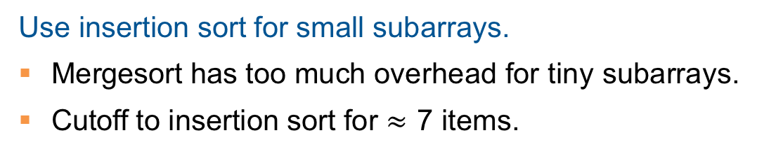
Mergesort: Practical Improvement
Use insertion sort for small subarrays.
Mergesort has too much overhead for tiny subarrays.
Cutoff to insertion sort for $≈$ 7 items.
private static void sort(Comparable[] a, Comparable[] aux, int lo, int hi)
{
if (hi <= lo + CUTOFF - 1)
{
Insertion.sort(a, lo, hi); return;
}
int mid = lo + (hi - lo) / 2; sort (a, aux, lo, mid);
sort (a, aux, mid+1, hi); merge(a, aux, lo, mid, hi);
}

Slide 33


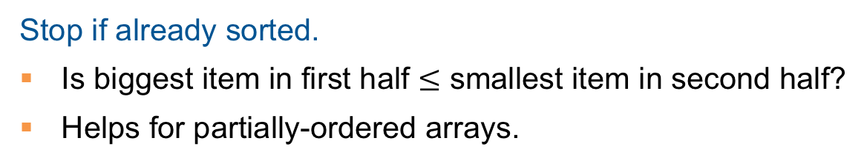
Mergesort: Practical Improvement
Stop if already sorted.
Is biggest item in first half $≤$ smallest item in second half?
Helps for partially-ordered arrays.
A B C D E F G H I J
M N O P Q R S T U V
A B C D E F G H I J M N O P Q R S T U V
private static void sort(Comparable[] a, Comparable[] aux, int lo, int hi)
{
if (hi <= lo) return;
int mid = lo + (hi - lo) / 2; sort (a, aux, lo, mid);
sort (a, aux, mid+1, hi);
if (!less(a[mid+1], a[mid])) return; merge(a, aux, lo, mid, hi);
}

Slide 34
Bottom-up Mergesort
Basic plan.
Pass through array, merging subarrays of size 1.
Repeat for subarrays of size 2, 4, 8, 16, ....
Simple and non-recursive version of mergesort. but about 10% slower than recursive, top-down mergesort on typical systems
a[i]
 |  |  |  |  |  |  |  | 0 | 1 | 2 | 3 | 4 | 5 | 6 | 7 | 8 | 9 | 10 | 11 | 12 | 13 | 14 | 15
sz = 1 |  |  |  |  |  |  |  | M | E | R | G | E | S | O | R | T | E | X | A | M | P | L | E
merge(a, aux, |  |  | 0, |  | 0, |  | 1) | E | M | R | G | E | S | O | R | T | E | X | A | M | P | L | E
merge(a, aux, |  |  | 2, |  | 2, |  | 3) | E | M | G | R | E | S | O | R | T | E | X | A | M | P | L | E
merge(a, aux, |  |  | 4, |  | 4, |  | 5) | E | M | G | R | E | S | O | R | T | E | X | A | M | P | L | E
merge(a, aux, |  |  | 6, |  | 6, |  | 7) | E | M | G | R | E | S | O | R | T | E | X | A | M | P | L | E
merge(a, aux, |  |  | 8, |  | 8, |  | 9) | E | M | G | R | E | S | O | R | E | T | X | A | M | P | L | E
merge(a, aux, |  |  | 10, |  | 10, |  | 11) | E | M | G | R | E | S | O | R | E | T | A | X | M | P | L | E
merge(a, aux, |  |  | 12, |  | 12, |  | 13) | E | M | G | R | E | S | O | R | E | T | A | X | M | P | L | E
merge(a, aux, |  |  | 14, |  | 14, |  | 15) | E | M | G | R | E | S | O | R | E | T | A | X | M | P | E | L
sz = 2
merge(a, | aux, | 0, |  | 1, |  | 3) |  | E | G | M | R | E | S | O | R | E | T | A | X | M | P | E | L
merge(a, | aux, | 4, |  | 5, |  | 7) |  | E | G | M | R | E | O | R | S | E | T | A | X | M | P | E | L
merge(a, | aux, | 8, |  | 9, |  | 11) |  | E | G | M | R | E | O | R | S | A | E | T | X | M | P | E | L
merge(a, | aux, | 12, |  | 13, |  | 15) |  | E | G | M | R | E | O | R | S | A | E | T | X | E | L | M | P
sz = 4
merge(a, aux, |  | 0, 3, 7) |  |  |  |  | E |  | E | G | M | O | R | R | S | A | E | T | X | E | L | M | P
merge(a, aux, |  | 8, 11, 15) |  |  |  |  | E |  | E | G | M | O | R | R | S | A | E | E | L | M | P | T | X
sz = 8
merge(a, aux,
0, 7, 15)
A E E E E G L M M O P R R S T X

Slide 35
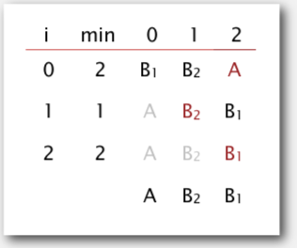
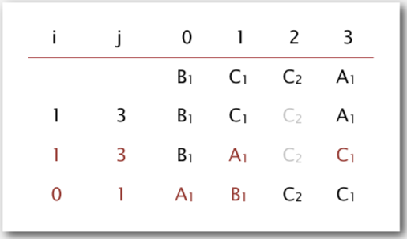
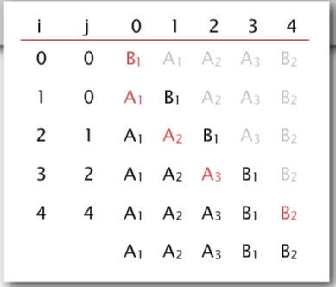
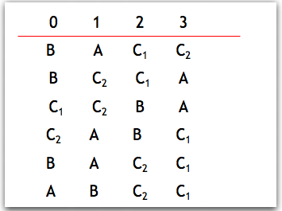
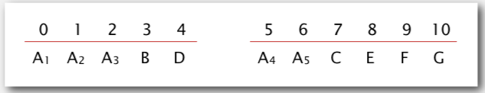
Stability of Sorting Algorithms
A stable sort preserves the relative order of items with equal keys.
selectsort is not stable
quicksort is not stable
insertsort is stable
mergesort is stable
heapsort is not stable

Slide 36
Summary
 | inplace? | stable? | best | average | worst | remarks
selection | ✔ |  | ½ n ² | ½ n ² | ½ n ² | n exchanges
insertion | ✔ | ✔ | n | ¼ n ² | ½ n ² | use for small n
merge |  | ✔ | ½ n lg n | n lg n | n lg n | n log n guarantee; stable
quick | ✔ |  | n lg n | 2 n ln n | ½ n ² | n log n probabilistic guarantee; fastest in practice
heap | ✔ |  | 3 n | 2 n lg n | 2 n lg n | n log n guarantee; in-place
? | ✔ | ✔ | n | n lg n | n lg n | holy sorting grail

Slide 37
Short Videos of Sorting Algorithms
Sort Algos // Michael Sambol Michael Sambol
https://www.youtube.com/playlist?list=PL9xmBV_5YoZOZSbGAXAPIq1BeUf4j20pl
Merge Sort, Quick Sort, Bubble Sort, Insertion Sort, Selection Sort, Heap Sort
Insertion Sort in 2 min (Python)
https://www.youtube.com/watch?v=ZS2ruPQm9QQ
Selection Sort in 2 min (Python)
https://www.youtube.com/watch?v=O6qX5xHXWpI
Bubble Sort in 2 min (Python)’
https://www.youtube.com/watch?v=2DNItBUngrA
Visual How
https://www.youtube.com/@visualhow/videos
10 Sorting Algorithms Easily Explained
https://www.youtube.com/watch?v=rbbTd-gkajw
Bubble Sort, Selection Sort, Insertion Sort, Merge Sort, Quick Sort, Heap Sort, Counting Sort, Shell Sort, Tim Sort, Radix Sort

Slide 38
Video Tutorials
Heap Sort
Heaps // Michael Sambol
https://www.youtube.com/playlist?list=PL9xmBV_5YoZNsyqgPW-DNwUeT8F8uhWc6
Binary Min Heap
https://www.youtube.com/playlist?list=PLvTjg4siRgU197GA1yFNRWUgsPZnvjuyL
HEAP SORT | Sorting Algorithms | DSA | GeeksforGeeks
https://www.youtube.com/watch?v=MtQL_ll5KhQ
Quick Sort
Quick sort in 4 minutes
https://www.youtube.com/watch?v=Hoixgm4-P4M&t=19s
Quicksort Algorithm: A Step-by-Step Visualization
https://www.youtube.com/watch?v=bZkzH5x0SKU
Visualization of Quick sort (HD)
https://www.youtube.com/watch?v=aXXWXz5rF64
Merge Sort
Merge sort in 3 minutes
https://www.youtube.com/watch?v=4VqmGXwpLqc
Notes:
What Is a Binary Heap? (Talks about min heap)
https://www.youtube.com/watch?v=AE5I0xACpZs

